Slide 1

LSAC 2018 hackaton
How to create LA services for different stakeholders

Slide 2
Main requirements for a new learning analytics platform
Start collecting data from students for students
Students decide if and how their data wil be shared with teachers, researchers and others within the institution
→ facilitate an individual treatment and a broader audience
Collect data for a specific question and store the data only for the purpose of that question
Minimize data per question
→ be GDPR compliant
Build a learning analytics platform
New questions (with their own datapoints) can be added to the platform
→ The platform is easier to expand

Slide 3
The shift: from one experiment to many services
service
Store data, minimized to answer the question → gather less data
Question
&
visualisation
Question
&
visualisation
Question
&
visualisation
Question
&
visualisation
LRS
data
data
Store activities in a fixed format from live sources → gather more data
source
source
source
source
source
source

Slide 4
Why are we at the hackaton?
We would like to discuss the process for developers to create services
Process: Question → recipe → data → algorithm → visualisation
Question and visualisation are related, this is the requirement from a stakeholder
The recipe describes the data and the algorithm to answer the question and output a visualisation

Slide 5
A typical process
Service: answering question X
Algorithm
Request
Visualisation
Data
Data in

Slide 6
Question and visualisation examples
Teacher: which students need special attention
Study counselor: What are the top 10 excellent students
Student 1
Student 23
Student 5
Student 78
Student 36
Student 14
Student 32
Student 5
Student 28
Student 9

Slide 7
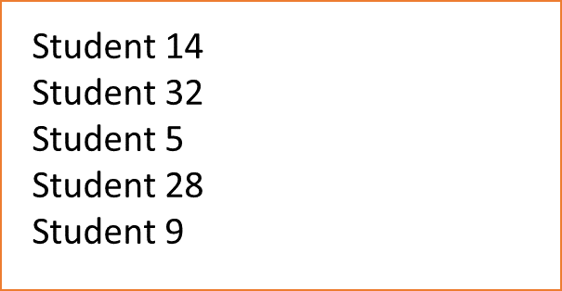
Recipe example
Last years’ grades
Per course
Per student
Top 10 excellent students
data
algorithm
Data 1
Filter out: students with a grade < 7
Calculate average per student (total / #courses)
Study points
Per course
Sort on highest average
Data 2
Calculate total study points per student
Filter out: students with study points < 60

Slide 8
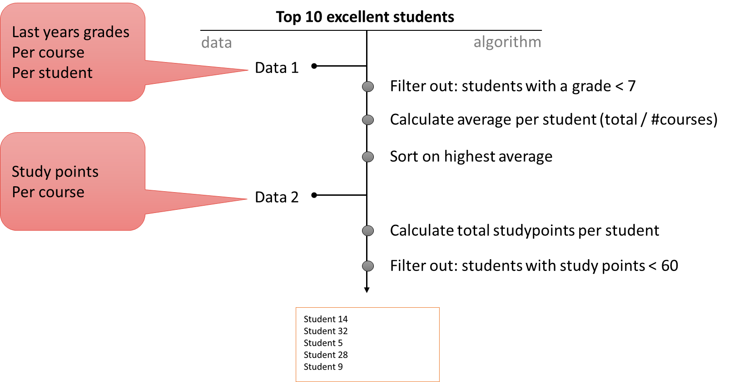
Can you help us?
Deciding on a model to describe recipes
Should we use xAPI to describe the data?
What language to use to run the algorithm?
How to output visualisation data OR output the visualisation itself?
Does the overall process make sense
are there any changes to be made?

Slide 9
ander.astudillo@surfsara.nl
Herman.vandompseler@surfnet.nl
Thank you
Notes:
De tekst zonder aanhalingstekens en zonder vraagteken. We willen hier graag ook nog de lijn plaatsen aan de rechterkant, maar dan in het wit.

